Slide 1
Breast Cancer Data Analysis
PRINCESS NWABULU
MICHAEL PETERS
TOM DANNER

Slide 2
Executive Summary (project and project goals)
Create accurate and reliable models to predict if somebody has breast cancer and which type of breast cancer they have.
Data Sets:
Breast Cancer Wisconsin - UC Irvin:
(https://archive.ics.uci.edu/dataset/17/breast+cancer+wisconsin+diagnostic)
BRCA – Kaggle
(https://www.kaggle.com/datasets/amandam1/breastcancerdataset)

Slide 3
BC Dataset - Selected Models
Breast Cancer Wisconsin - UC Irvine
Neural Network
XGB Classifier
Logistic Regression
Support Vector Machine
Notes:
The selected model. (5 points)
Describe the machine learning model that your group selected and why.

Slide 4
BRCA Dataset - Selected Model
BRCA – Kaggle
Neural Network
Sequential Neural Network
Support Vector Machine
K-Nearest Neighbors- KNN

Slide 5
Data Preparation Process
Describe the source of your data and why you chose it for your project.
Kaggle is well known source for data sets.
we choose the BC data because of its large set of features to predict a cancer cell.
Describe the collection, cleanup, and preparation process.
Collection searching on Kaggle for usable datasets
Identifying feature and target wanted, dropping unwanted columns, transforming data into format the models will work with using One Hot Encoder, Label Encoder, and to categorical, then Standard Scaler to scale the sets.
Describe the training process.
Separating the features and target into training and testing datasets, scaling the datasets, fitting the data into the models, predicting results based on the testing data.
Notes:
The data preparation and model training process. (3 points)

Slide 6
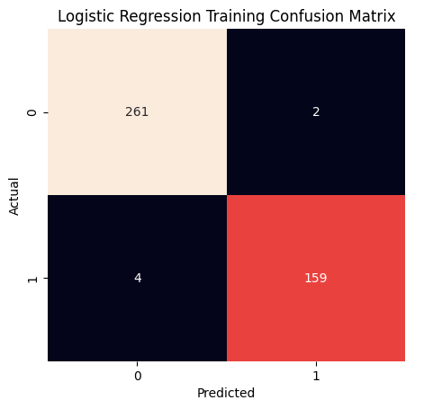
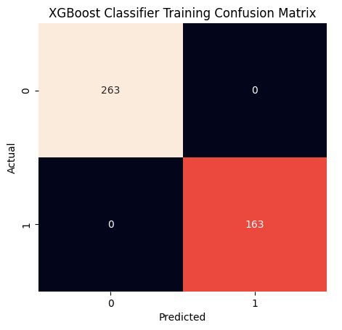
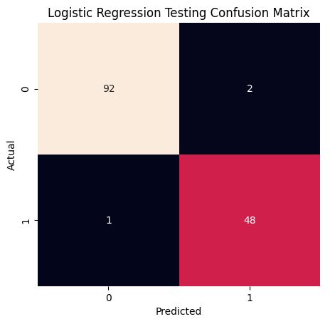
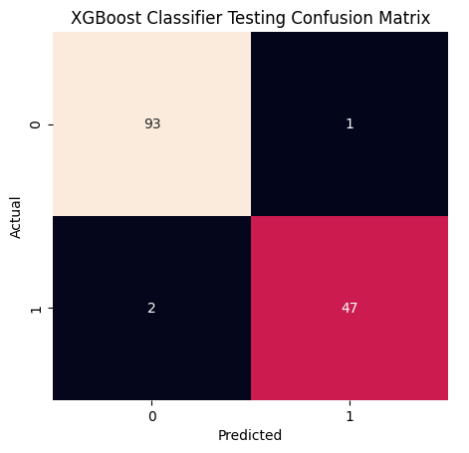
BC Dataset – Logistic Regression vs. XGBoost Classifier

Slide 7
BC Dataset – Classification Reports
Logistic Regression Model Training Classification Report
--------------------------------------------------------
precision recall f1-score support
0 0.98 0.99 0.99 263
1 0.99 0.98 0.98 163
accuracy 0.99 426
macro avg 0.99 0.98 0.99 426
weighted avg 0.99 0.99 0.99 426
________________________________________________________
Logistic Regression Model Testing Classification Report
--------------------------------------------------------
precision recall f1-score support
0 0.99 0.98 0.98 94
1 0.96 0.98 0.97 49
accuracy 0.98 143
macro avg 0.97 0.98 0.98 143
weighted avg 0.98 0.98 0.98 143
XGB Classifier Model Training Classification Report
--------------------------------------------------------
precision recall f1-score support
0 1.00 1.00 1.00 263
1 1.00 1.00 1.00 163
accuracy 1.00 426
macro avg 1.00 1.00 1.00 426
weighted avg 1.00 1.00 1.00 426
________________________________________________________
XGB Classifier Model Testing Classification Report
--------------------------------------------------------
precision recall f1-score support
0 0.98 0.99 0.98 94
1 0.98 0.96 0.97 49
accuracy 0.98 143
macro avg 0.98 0.97 0.98 143
weighted avg 0.98 0.98 0.98 143

Slide 8
BC Dataset
Neural Network
Setup
Results
Layers
Evaluation
nn.add(Dense(units=16, input_dim=31, activation="relu"))
nn.add(Dense(units=8, activation="relu"))
nn.add(Dense(units=1, activation="sigmoid"))
loss: 0.1247
categorical_accuracy: 0.9650
Predictions
Compilation
Benign (0.0) - 88
malignant (1.0) - 55
nn.compile(loss="binary_crossentropy", optimizer="adam", metrics=["accuracy"])
Fitting the model
nn.fit(X_train_scaled, y_train, epochs=200)

Slide 9
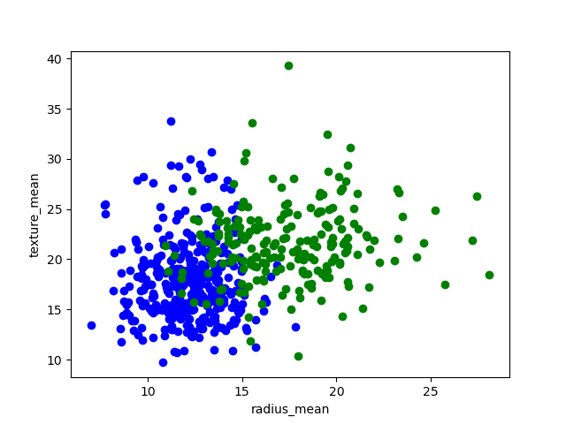
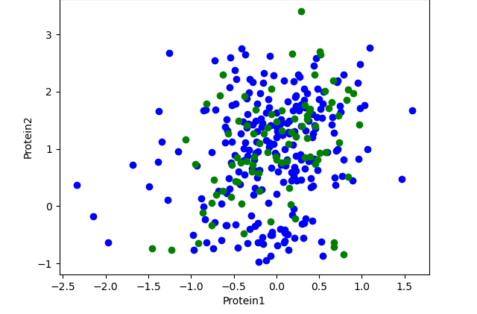
BC Dataset svm
BRCA data
BC data

Slide 10
Data Preprocessing
BC Data
559 rows/31 columns
no nulls
y= diagnosis
x= drop diagnosis
BRCA Data
Dropped 6 columns
one hot encoder(histology)
nan after encoding
y= histology
x= drop histology

Slide 11
SVM
BC Data
Kernel selection - Linear
Parameter Tuning- N
80% train set
random state=1
Acc score = 0.96
BRCA Data
imbalanced data?
Parameter Tuning- N
80% train set
random state=1
Acc score = 0.58

Slide 12
ann/knn
BC Data
ANN
Tuning- N
BRCA Data
KNN
Tuning- y
neighbor classifier- 2,3,4
2 accuracy= 0.51
3 accuracy= 0.46
4 accuracy= 0.55

Slide 13
BRCA Dataset
Neural Network
Setup
Results
Layers
Evaluation
nn.add(Dense(units=7, input_dim=14, activation="relu"))
nn.add(Dense(units=4, activation="relu"))
nn.add(Dense(units=2, activation="relu"))
nn.add(Dense(units=1, activation="relu"))
nn.add(Dense(units=1, activation="relu"))
loss: (NaN)
categorical_accuracy: 0.6429
Predictions
Compilation
Infiltrating Ductal Carcinoma (0.0) - 54
Mucinous Carcinoma (1.0) - 4
Infiltrating Lobular Carcinoma (2.0) - 20
No Prediction (NaN) - 6
nn.compile(loss="binary_crossentropy", optimizer="adam", metrics=["accuracy"])
Fitting the model
nn.fit(X_train_scaled, y_train, epochs=50)

Slide 14
BRCA Dataset Sequential Neural Network
Setup
Results
Layers
Evaluation
(Dense(25, input_dim = number_of_predictors, activation = 'relu'))
(Dense(25, activation = 'relu'))
(Dense(25, activation = 'tanh'))
(Dense(25, activation = 'tanh'))
(Dropout(.1))
(Dense(number_of_classes, activation='softmax’))
loss: 0.1370
categorical_accuracy: 0.6875
Predictions
Infiltrating Ductal Carcinoma - 80
Compilation
(loss="categorical_focal_crossentropy", optimizer= "adam", metrics=['categorical_accuracy’])
Fitting the model
number_of_epochs = 200
nn.fit(X_train_scaled, y_train, epochs = number_of_epochs, shuffle = True)

Slide 15
Group Approach to Achieve Project Goals
Evaluation Methods
.evaluate (Neural Networks)
confusion matrix, classification report(Logistic Regression/XGB Classifier)
Unanticipated Problems
NaNs in y_test (Neural Network BRCA)
Low accuracy score for the BRCA model.
How to display the Confusion Matrix.

Slide 16
Results / Conclusions
Almost perfectly predict if somebody had cancer.
BC Dataset
96.5% Accurate (Neural Network)
99% training, 98% testing Accuracy (LR Model)
100% training, 98% testing Accuracy (XGB Classifier Model)
95.6% accurate (SVM)
Not able to predict the type of cancer based on the provided data with enough accuracy.
BRCA Dataset
68.75% Accurate (Sequential Neural Network)
64.29% Accurate (Neural Network)
58.20% Accurate(SVM)
55% Accurate(KNN)

Slide 17
Next Steps
BC Dataset
Find more testing data
Testing Accuracy >98%
BRCA Dataset
Deeper analysis of model failure.
Try to determine which features are necessary to predict cancer type
Find Larger dataset for training
Try over sampling or SMOTE to account for imbalanced targets.

